Slide 1
The IoT Explosion and What It Means for Cybersecurity
Sean Duval

Slide 2
Topics of Discussion
Internet of Things (IoT)
Network Tap / Span
APIs / Integrations

Slide 3
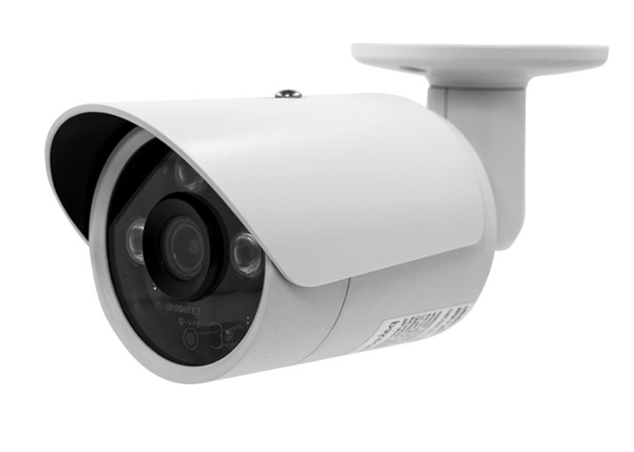
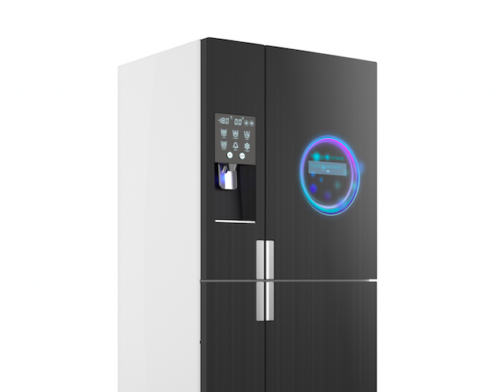
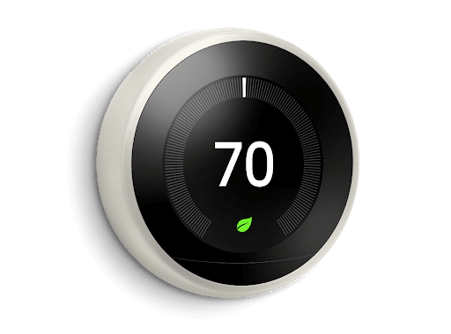
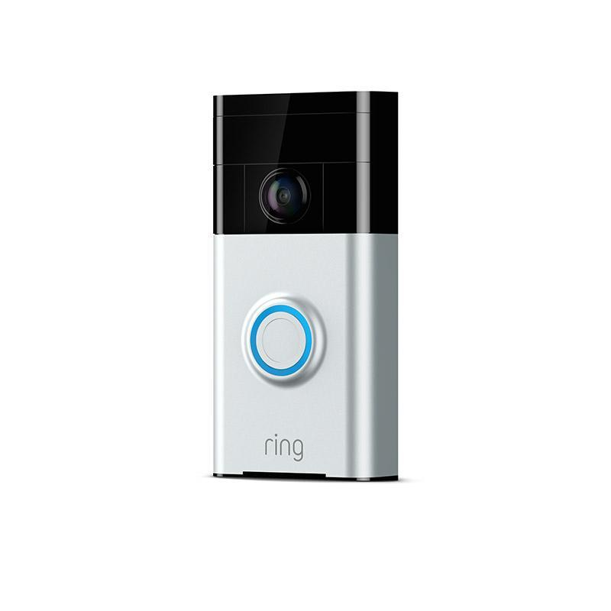
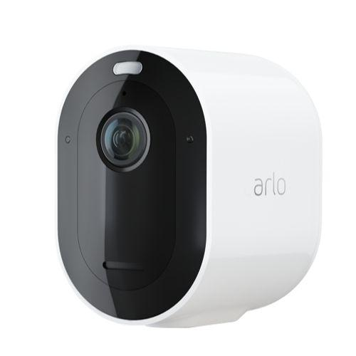
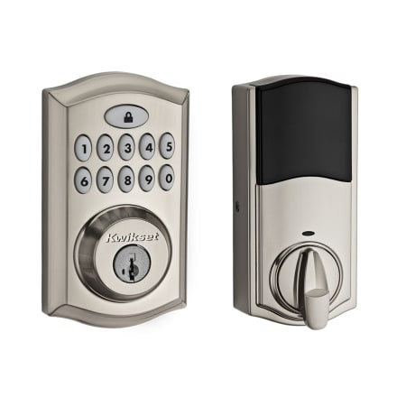
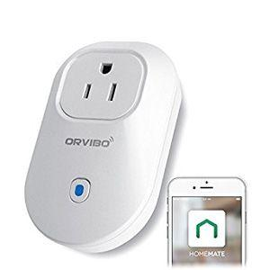
IoT Devices & Products
Notes:
Examples of IoT Devices. We interact with the devices everyday. And you may or may not pay attention to these devices as users. But each of these devices represents an attack target for hackers.

Slide 4
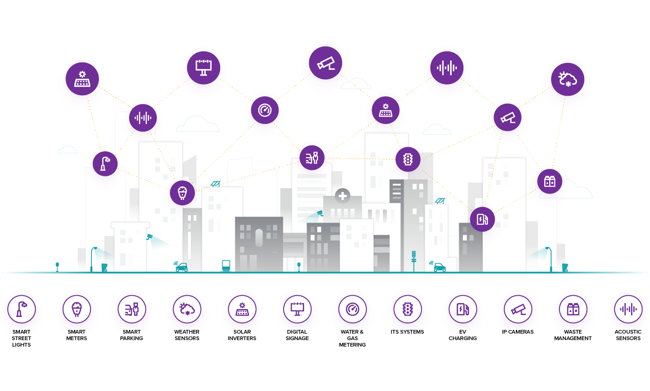
“Smart” Devices Have Changed The Way We Live
Notes:
We rely on these IoT devices each and every day. They are now part of the critical infrastructure in our world. Therefore, the need to ensure the Confidentiality, Integrity, and Availability of these assets.
Otherwise we will see huge impacts on our home lives, our companies and our society as a whole.

Slide 5
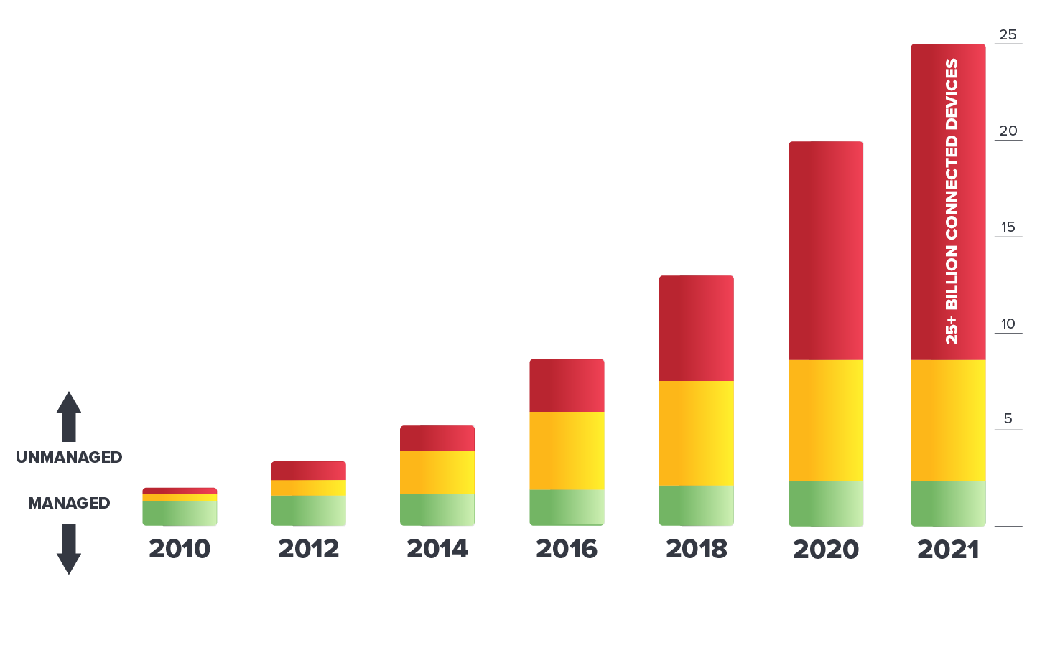
Securing Smart Devices
Up To 90% of Devices Will Be Unmanaged
Cloud Assets
Virtual Machines
VOIP
Security Cameras
Switches
Access Points
Printers
Bluetooth
Unmanaged & IoT
Point of Sale
Smart TVs
Medical Devices
Smart HVAC
Manufacturing
Smart Lighting
Smartphones
BYOD (PC & Mobile)
Tablets
Laptops
Web, PCs and Servers
Traditional Enterprise
Source: Armis research and various market analysts
Notes:
Enterprises are experiencing a huge business transformation resulting in an explosion of connected devices - bigger than the number of PC and mobile devices combined.
By 2021, up to 90% of these devices will be unmanaged and IoT devices. These new devices include everything from industrial control systems and PLCs, to medical devices, to smart TVs, security cameras, digital assistants, printers, HVAC systems, and more.
But these devices were not designed with security or management in mind and cannot be protected in the same manner as traditional devices. This makes them valuable targets for malicious exploitation. The risk is massive because these new devices come with the following distinct characteristics:
Designed to connect – Unlike previous devices in the workplace, these devices are designed to automatically connect to the Internet or to other devices.
No built-in security – Most of these devices are unable to accept a traditional security agent for either protection or monitoring. They are un-agentableTM.
Difficult to upgrade – Most of these devices have embedded operating systems (Linux, Windows CE, Android, VxWorks) that are either difficult or impossible to routinely update, so over time they can accumulate a large number of common software vulnerabilities.
Under attack – Recent reports show attacks on unmanaged and IoT devices are up 300% in 2019. The FBI and the US-CERT have issued warnings that these devices are increasingly under attack.
Explosion of these new devices and the challenges of security them has effectively broken traditional security approaches.

Slide 6
None of these IoT devices can have an agent installed
How do we monitor them?

Slide 7
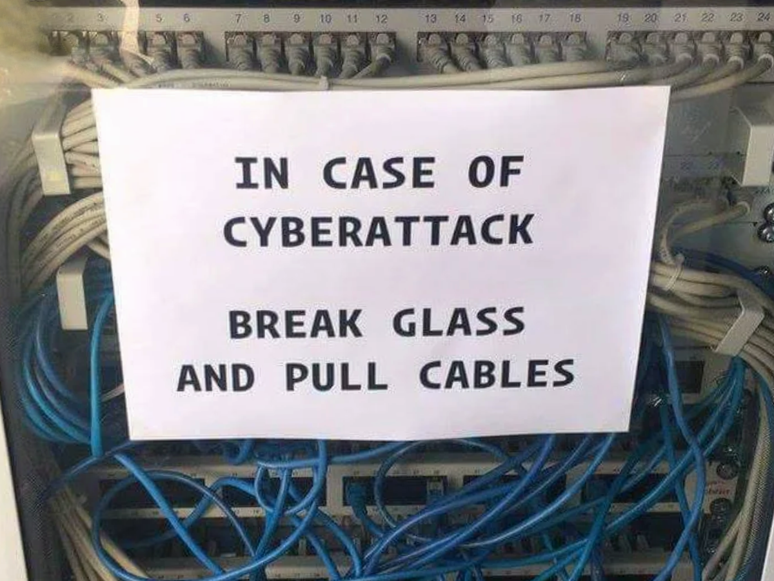
99%
of cyber attacks traverse the network in some way

Slide 8
Network Span / Tap Traffic

Slide 9
Network Traffic for Cybersecurity
Benefits
If you want to know what is happening on the network–look at the network
Network Traffic can help detect:
Devices and their behavior
Risks and Threats
Anomalies and suspicious behavior
The contents of network conversations (payload)
Challenges
Volume of data and cost of storage
Balancing the correct amount of payload data vs metadata (recording a phone call vs looking at the phone bill)
Encryption
Last mile problem of capturing all network connections

Slide 10
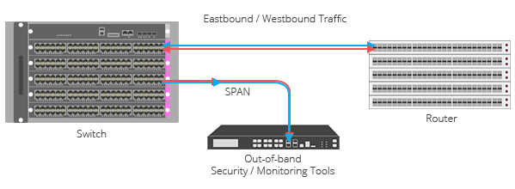
Network SPAN
SPAN (Switched Port Analyzer) is a dedicated port on a switch that takes a mirrored copy of network traffic from within the switch to be sent to a destination. The destination is typically a monitoring device, or other tools used for troubleshooting or traffic analysis.
Notes:
https://www.garlandtechnology.com/tap-vs-span

Slide 11
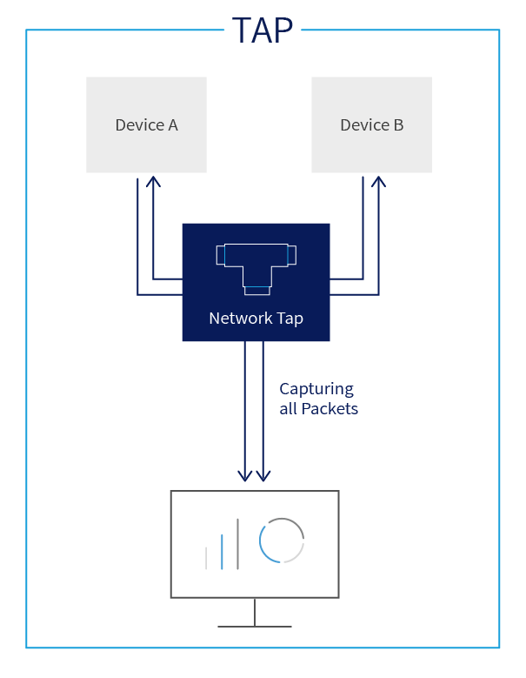
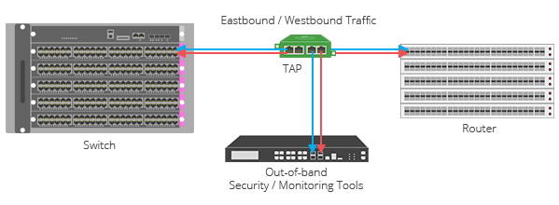
Network TAPs
Network TAPs are a purpose-built hardware device that sits in a network segment, between two appliances (router, switch or firewall), and allows you to access and monitor the network traffic.

Slide 12
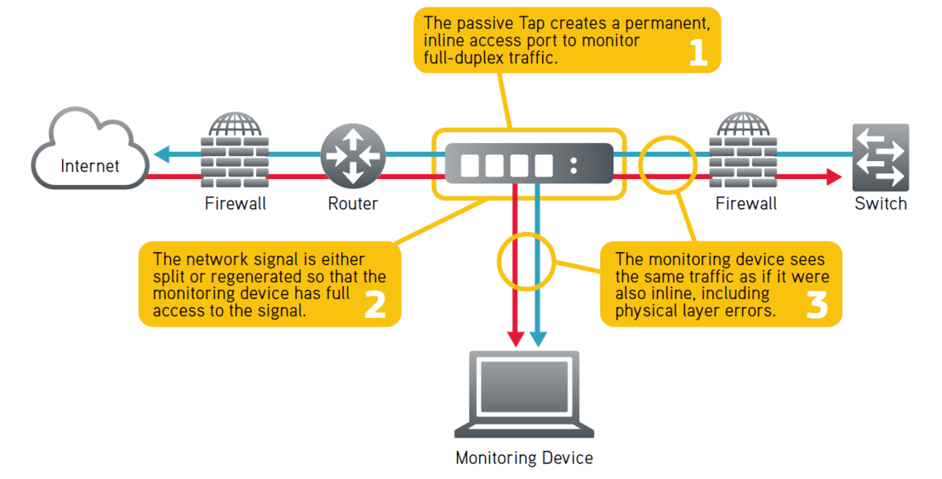
Network TAPs

Slide 13
API (Application Programming Interface)

Slide 14
API (Application Programming Interface)
An application programming interface (API) is a way for two or more computer programs to communicate with each other.
In contrast to a user interface, which connects a computer to a person, an application programming interface connects computers or pieces of software to each other. It is not intended to be used directly by a person (the end user) other than a computer programmer who is incorporating it into the software.
The term API is often used to refer to web APIs, which allow communication between computers that are joined by the internet. There are also APIs for programming languages, software libraries, computer operating systems, and computer hardware.
Notes:
https://www.garlandtechnology.com/tap-vs-span

Slide 15
API (Application Programming Interface) Example
REST (Representation State Transfer)
JSON
SOAP (Simple Object Access Protocol)
XML
RPC (Remote Procedural Call)
XML or JSON
Notes:
https://www.garlandtechnology.com/tap-vs-span

Slide 16
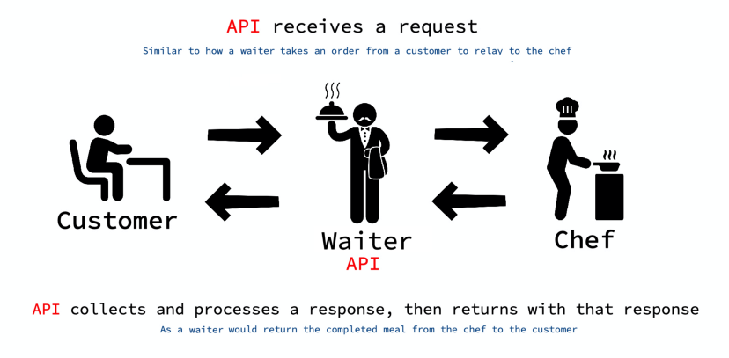
API Analogy

Slide 17
Example to the Right, Google Maps is using Uber’s API to request information by sending a HTTP request function with the start and end points of the ride.
Uber’s API then sends information back such as how many cars are available, where are they currently located, and the costs for the various ride options.
This information is then processed by Google Maps and is available to the user directly linking them the the Uber app if it is previously downloaded.

Slide 18
APIs in Cybersecurity (Integrations)
Pull data: We can leverage the APIs of our different cybersecurity tools to pool together the different “silos” of data into a single common datastore.
Push data: Share data from one tool to another to speed up manual “copy and paste” workflows.
Actions: Launch an action in one system automatically from another system.

Slide 19
Armis

Slide 20
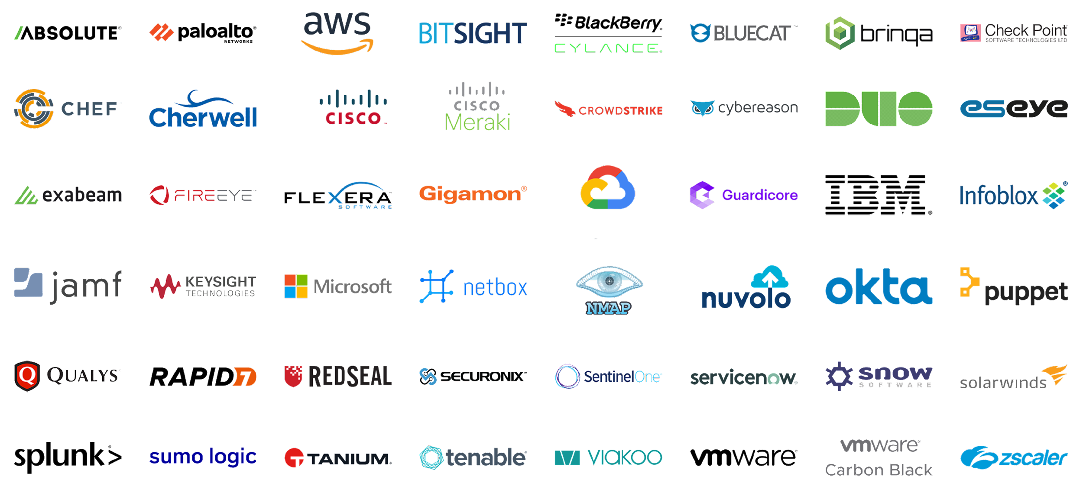
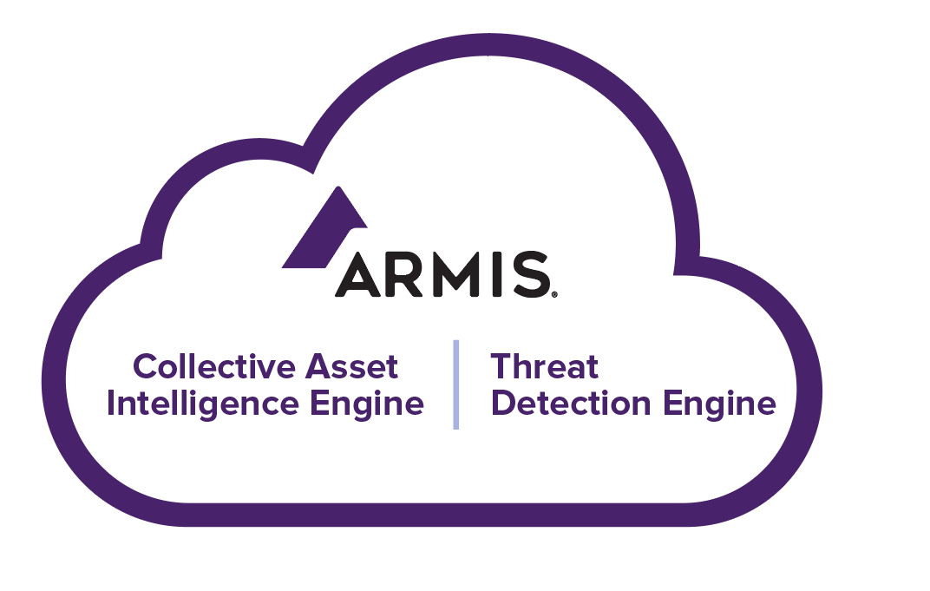
Asset Identification and Management
APIs
Deep packet inspection provided with Armis collectors.
Some of our featured, prebuilt integrations.
collectors
MANAGED AND
UNMANAGED DEVICES
CLOUD & VIRTUAL
OT / IOT / IOMT DEVICES
Notes:
Armis Knowledge Base has over 3 billion assets.
Armis integrates with hundreds of IT and security tools to gather and analyze asset data across all environments and asset types, to provide multidimensional, contextual asset views, and actionable insights.

Slide 21
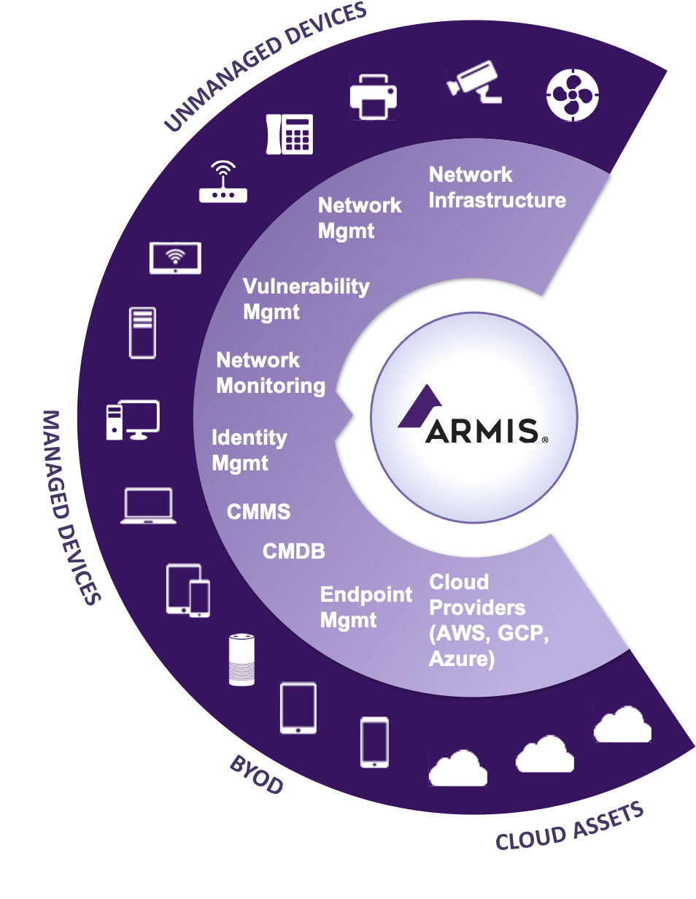
Complete. Unified. Actionable.
Fast to deploy
No agents
Deploys in minutes to hours
Integrates into existing IT & security solutions
No network impact
Saves 100+ person-hours per year
Notes:
What Armis Does ?
Armis delivers cybersecurity asset management that is complete, unified, and fully actionable. We integrate or connect in numerous ways across your environment. From you IT and security management solutions, to cloud assets to CMDBs to endpoint mgmt to your vulnerability tools.
We bring all these data together in a fast and simple method.
There are no agents
No complication integrations
Deploy in minutes to hours
There is little or no network impact
And in fact, with Armis you can save time and resources.
No more chasing down assets with a clipboard or spreadsheet
And yes, you can run reports for all types of assets

Slide 22
Agentless Device Security Platform
What Do I Have?
Why Do I Care?
What Action?
Full asset inventory
Identify & classify
Managed, unmanaged, IoT
Track behavior & traffic
Provide threat assessment
Quarantine devices
Suspicious or malicious
Discover
Analyze
Protect
www.armis.com
Copyright Armis Inc. 2022
Notes:
Armis is the leading agentless device security platform purpose-built to protect the world of unmanaged and IoT devices.
It provides passive, real-time and continuous protection to enable large organizations to benefit from the latest connected devices without fear of compromise from a cyber attack.
We provide three critical functions to address the unmanaged and IoT device security blind spot:
1) Asset Inventory
The most comprehensive device discovery and asset inventory of devices on and off the network
Device identification and classification
Managed, unmanaged, and IoT devices
Across every industry or vertical
The ability to provide this information to an CMDB or asset tracking system
2) Identifies Risks and Gaps
Armis brings Risk Management to these new unmanaged devices. We provide:
Passive, real-time continuous vulnerability assessment with deepest device behavior and threat intelligence
An extensive CVE and compliance Database
All of which lets us provide smart adaptive risk scoring for devices
As well as risk-based policies and auto-segmentation
3) Automates Policy Enforcement
Lastly, we bring critical detection & response, as well as remediation of threats to compromised devices. Armis can:
Track the device behavior, connections and history
Track that behavior and any anomalies against our Collective Asset Intelligence Engine
Disconnect or quarantine devices
Integrate with and provide full device context to every SOC tool or workflow (such as SIEM, Ticketing, Firewall, NAC, etc.)
The companies listed here are just a few of those we work with today.
Any questions?

Slide 23
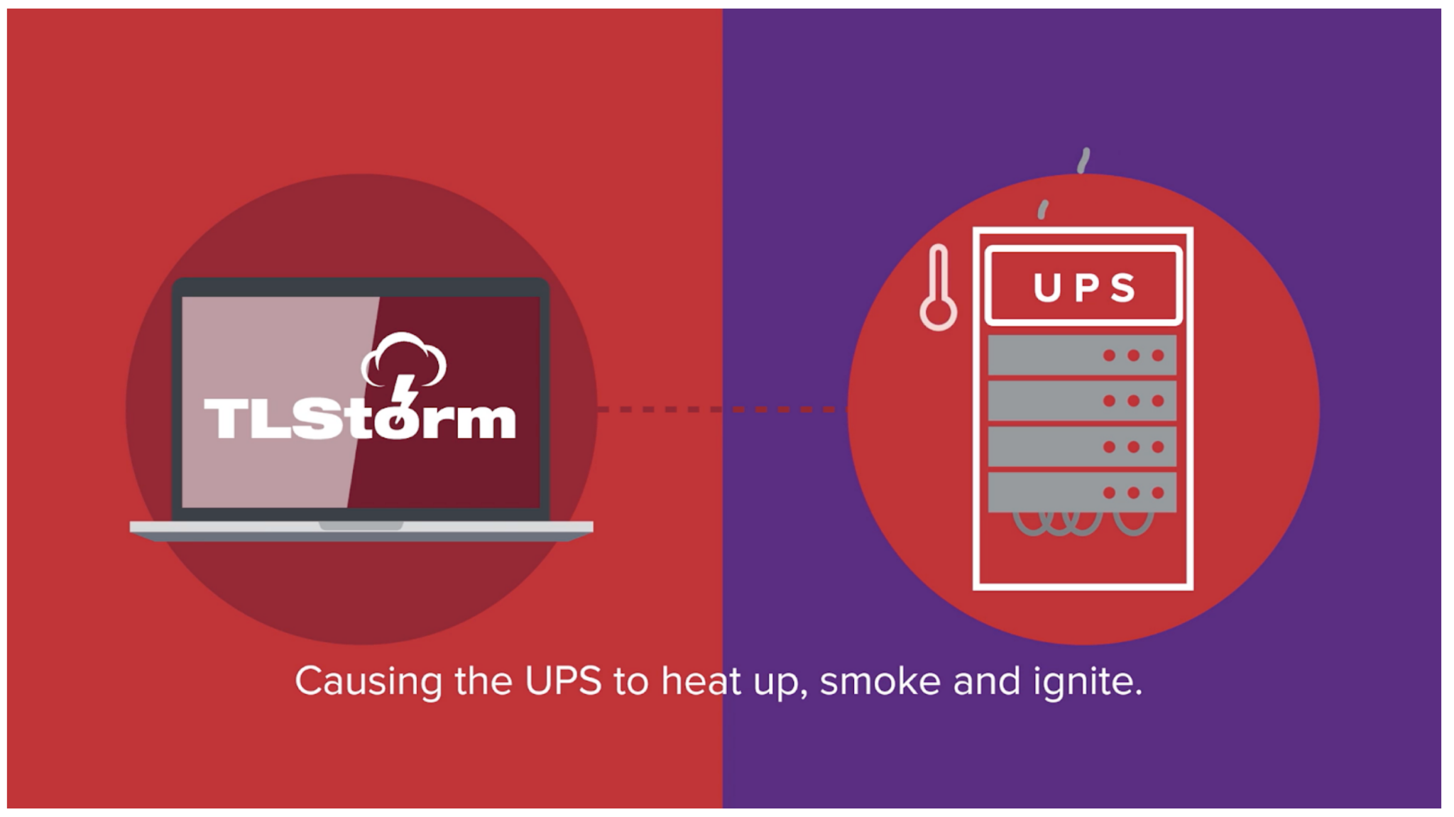
Armis Research – TLStorm
Notes:
Question – Does anyone know what an UPS system is – uninterruptible power supply.
These are the backup batteries for critical computers and servers in data centers around the world. Armis discovered ways to in which attackers could carry out hacks against these critical, internet-connected devices and not just steal information or spread malware. But also physically destroy the UPS systems and the devices connected to them for power. When we think about the devices in the red section from the other slide, similar types of damage can be done from each one of those smart devices.

Slide 24
Armis Research – TLStorm
Notes:
Question – Does anyone know what an UPS system is – uninterruptible power supply.
These are the backup batteries for critical computers and servers in data centers around the world. Armis discovered ways to in which attackers could carry out hacks against these critical, internet-connected devices and not just steal information or spread malware. But also physically destroy the UPS systems and the devices connected to them for power. When we think about the devices in the red section from the other slide, similar types of damage can be done from each one of those smart devices.

Slide 25
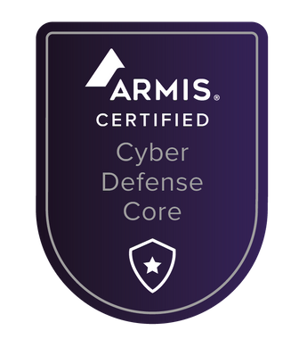
Badge
Upon completion of the course, you will earn a badge that you can share on LinkedIn and add to your resume/CV.

