Slide 1
NextGen Solution Training: Focusing in on Security Information and Event Management (SIEM)
Scott Rossi
Sr. Director, IT Security Engineering
Gilead Sciences
October 4th, 2021

Slide 2
What month is it?
Cyber Security Awareness Month – Great timing to be here together!
Find more interesting info on cyber awareness here:
https://www.cisa.gov/cybersecurity-awareness-month

Slide 3
A quick note about me…
Current Role: Head of IT Security Engineering at Gilead Sciences. Work experience includes Genentech and Levi Strauss
Non-traditional path to get here…
J. Eugene McAteer High School – San Francisco, CA
Cabrillo College – Aptos, CA
Mesa College – San Diego, CA
City College of SF, San Francisco, CA
San Francisco State University
BA International Relations
BA Spanish
George Washington University
Master’s Latin American Studies: Economics
Part-time job at Genentech doing Disaster Recovery & Cyber Security
Take aways… There is no “one” path
Follow your interests
Say “Yes” to opportunities as they arise

Slide 4
Agenda
Quick Introduction to me and our topic -- What internship candidates are learning in the training program
NextGen partners with leading cyber solution vendors to provide training
SIEM a case study: Securonix Snypr, a next gen SIEM / UEBA
What is SIEM, who uses it and why it’s awesome
SIEM 1st gen – Example of SIEM rules and how they help
SIEM next gen – what do analytics / ML bring to the table
Is this a valuable skill that will help you start a career in cyber? Yes!!

Slide 5
What NextGen Students Are Learning: Tech Focus
NextGen Cyber Talent (NGCT) helps candidates get started with education and careers in the broader cyber space industry
NGCT has partnerships with key cyber solution providers
Security Information and Event Management (SIEM)
Insider Threat
Incident Response, etc.
Partner organizations provide training to NextGen Cyber Talent students

Slide 6
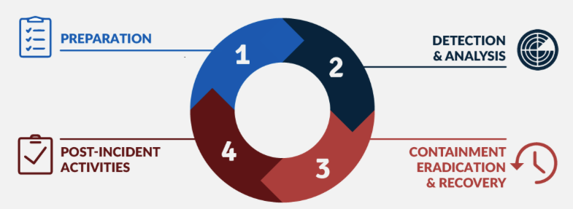
How enterprises manage cyber risk & incident response
The NIST Framework helps enterprise plan for and address all elements of cyber risk
The Incident Response lifecycle helps guide activities connected to a cyber attack / breach type event
https://www.nist.gov/cyberframework
Incident Response Lifecycle
Notes:
Image from: https://www.forescout.com/blog/how-to-comply-with-the-5-functions-of-the-nist-cybersecurity-framework/
Also check here for a good writeup
The NIST Standard itself: https://www.nist.gov/cyberframework
https://blog.elearnsecurity.com/the-4-steps-of-incident-handling-response.html

Slide 7
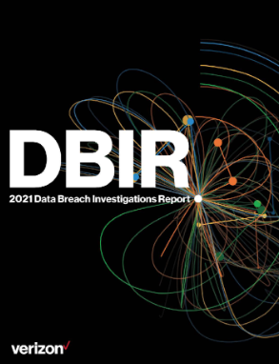
Verizon Data Breach Report – Read it!!
Annual report that summarizes major trends in cyber / breach events
https://www.verizon.com/business/resources/reports/dbir/
Free to download, super readable & fascinating data
Dwell Time!
Notes:
Article on dwell time: https://www.forbes.com/sites/forbestechcouncil/2021/05/03/why-the-dwell-time-of-cyberattacks-has-not-changed/?sh=b259bfd457d8

Slide 8
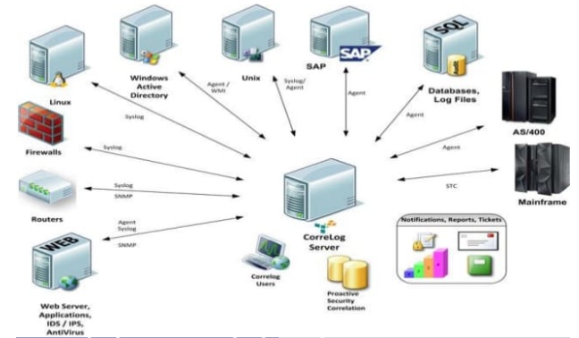
The concepts & key questions: What is SIEM? Why is it important?
Enterprise level organizations need to quickly identify and appropriately respond to cyber events
A framework within which to work is key
Prioritization is critical
What is a SOC? Who is a SOC analyst?
How is SIEM connected to the SOC?
Notes:
Image from guidepoint security
Architecture pic from: https://www.slideshare.net/pathinishanth/siem-architecture

Slide 9
SIEM v1 Use Case
Brute Force Login Attack Dashboard
As a SIEM engineer, I once saw an example like this. For a SOC Analyst, why should this make the hair on the back of your neck stand up???
Rule config: Brute force login attack will fire for 10 failed logins from the same IP for the same user name in 1 minute
Event time | Source Address | Destination Address | Destination Host Name | User Name | Source Country
02:17:23 AM | 103.14.104.x | 10.0.10.200 | DC200.company.com | root | Romania
02:19:13 AM | 109.199.128.x | 10.0.20.207 | DC207.company.com | root | Bulgaria
02:19:17 AM | 103.136.43.x | 10.0.10.200 | DC200.company.com | sys | Russia
02:19:17 AM | 69.162.81.x | 10.0.20.207 | DC207.company.com | system | United States
02:19:17 AM | 102.23.167.x | 10.0.10.203 | DC203.company.com | sa | Nigeria
02:19:21 AM | 121.69.48.x | 10.0.10.201 | DC201.company.com | administrator | China
02:19:26 AM | 1.177.255.x | 10.0.10.200 | DC200.company.com | sa | Korea
02:19:28 AM | 102.129.65.x | 10.0.20.207 | DC207.company.com | root | France
02:19:30 AM | 132.255.164.x | 10.0.10.201 | DC201.company.com | administrator | Paraguay
02:19:31 AM | 2.103.255.x | 10.0.10.203 | DC203.company.com | sa | England
02:19:32 AM | 103.146.97.x | 10.0.10.200 | DC200.company.com | administrator | Russia
History – SIEM first started to appear in early 2000’s. Simple, rules based alerts. At this point, events per second (EPS) was limited and searching could take hours
Notes:
Frequency is nearly constant
Happening in the middle of the night
Do I even have users on the Source address countries where I don’t have any users
These are all privileged accounts
Worst one – external IP addresses are showing up in the logs of my domain controllers. These DCs are behind a FW and are not intended to be exposed to the internet at all (so these brute force attacks should not even be possible)

Slide 10
Next Generation SIEM
Next Generation SIEM solutions take advantage of Machine Learning / Artificial Intelligence to enhance detection and response
Simple rules-based plus…
User / Entity behavior analytics
Consolidated risk score across activities
Base line assessments
Peer group analysis
Land / Speed Violations
Automated response capabilities

Slide 11
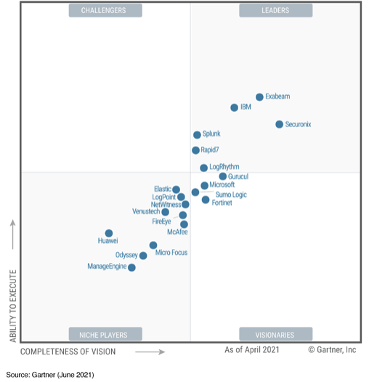
Is this a valuable skill that will help you start a career in cyber? Yes!!
Gartner Magic Quadrant for SIEM
Training in Securonix Snypr provides a clear path to SOC analyst & SIEM engineer roles
Concepts transferable across specific SIEM solutions
Remember… There is no “one” path
-Follow your interests
-Say “Yes” to opportunities

Slide 12
Thanks!! Questions?? scott.rossi@gilead.com

